Slide 1



























E: ourmail@thecavelab.com | Phone/Fax. (028) 876532
Multipurpose Proposal Project | highly made with professional layout 1
A semiconductor material supplier led by professional technology
Please refer to the inner page for the contact details of each branch office!
產品目錄
FAIRFIELD CATALOGUE
Taiwan Fairfield Electronic Technology Co.,Ltd.
台灣銘奮電子科技有限公司
+886 939603219
T Tony_Wang@Fairfield.com.tw
Contacting Person : Tony Wang
Ver. 202406
A semiconductor material supplier led by professional technology

Slide 2



關於銘奮
專業的技術為先導的電子材料供應商
台灣銘奮電子科技有限公司是一家以銷售半導體封裝及電子材料為主，以提供工 程設計及解決方案、強大的技術支援為輔的高科技材料公司。 熱灌封膠、結構膠、矽鋁、金剛石銅等。 公司的產品覆蓋了：半導體封裝、電子組裝、工業工程、氣密性封裝、光通訊、 LED封裝和照明、共六大行業。典型產品有、絕緣膠、導電銀漿和納米銀漿、導熱灌封膠、結構膠、研磨膜、切割膜 , DAF 膜等.

Slide 3














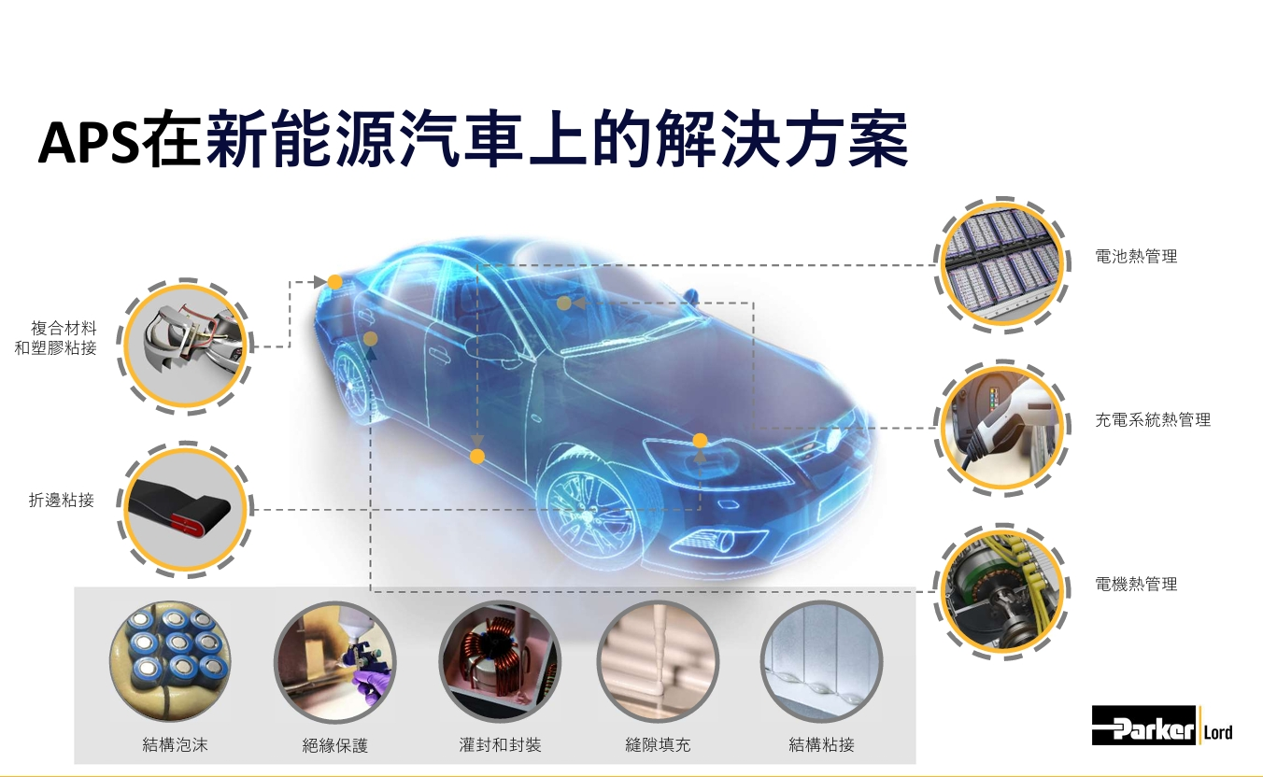




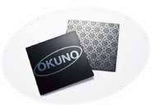




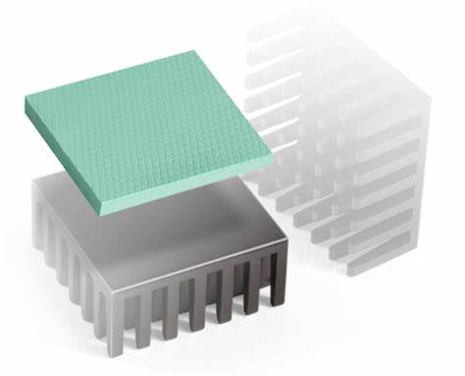
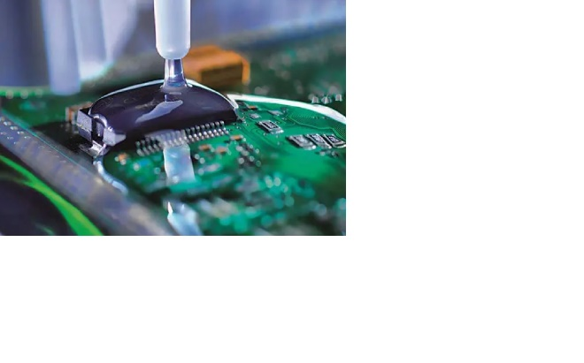
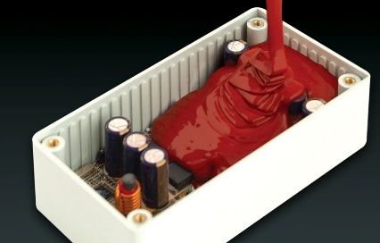
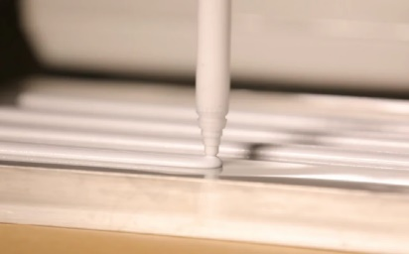
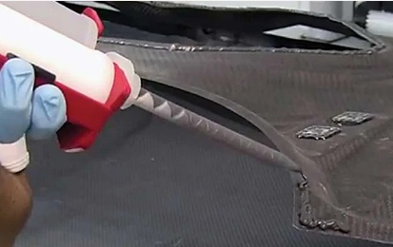
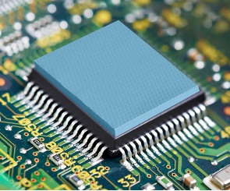
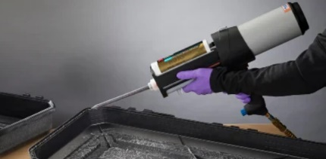
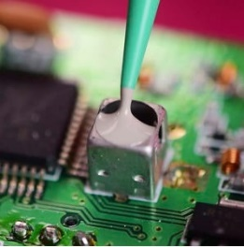

佈局全球
產品目錄
A 氣密性封裝
晶片粘接膠 ........................................................................................ STAYDRY® 吸氫吸濕片 ..................................................................
密封蓋板 ............................................................................................ |  | 株 式 会 社 巴 川 製 紙 所
紅外外殼、管座和杜瓦組件 ...........................................................
光調製器殼體 ....................................................................................
銀焊合金 ............................................................................................
高溫合金、鋁合金、銅合金、含磷釺料 ......................................
高純度合金 ........................................................................................
焊粉、焊膏、釺劑、軟釺料、NuTEC .........................................
包銅引線 ............................................................................................
矽鋁合金 ............................................................................................
半導體熱源散熱器 ...........................................................................
厚膜材料 ............................................................................................
鋁合金金屬 ........................................................................................
電子零部件用“裝飾塗料” ...........................................................
電子零部件用“高耐腐蝕塗料” ..................................................
電子零部件用“玻璃料劑” 和 “玻璃漿料” ........................... 金剛石鋁 ............................................................................................ |  | 费 尔 德
B LED 封裝和照明
高導熱銀膠 .......................................................................................
納米燒結銀漿 ...................................................................................
Mini LED 用焊料 .............................................................................

Slide 4



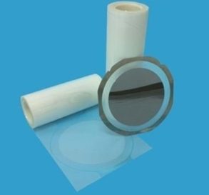


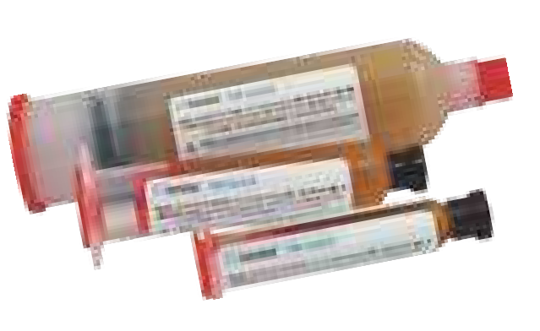
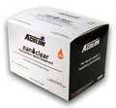

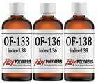



產品目錄
產品目錄
C 電子組裝
微波吸收材料 ...............................................................................
微電子材料 ...................................................................................
電子灌封材料 ...............................................................................
導熱材料 .......................................................................................
助焊劑/錫膏/膠水 .......................................................................
針筒式錫膏 ...................................................................................
錫膏 ............................................................................................... TIMS 導熱介面材料解決方案 ...................................................
锡膏印刷模板纳米涂层 ..............................................................
電子產品防水塗層 .......................................................................
D 半導體封裝
針筒式錫膏 .....................................................................................
預成型焊錫 .....................................................................................
鋁線/鋁帶/金線/金帶 ...................................................................
旋塗玻璃材料 .................................................................................
雙塗膠 .............................................................................................
背面保護薄膜 .................................................................................
背面研磨膠帶 .................................................................................
晶片粘接膜 (DAF) .........................................................................
切割膠帶 .........................................................................................
E 工業工程
結構膠粘劑 .......................................................................................
磁鐵塗料 ...........................................................................................
D 半導體封裝
微電子材料 ...................................................................................
MEMS 上的應用介紹 .................................................................
各向異性導電粘著膠 ..................................................................
納米燒結銀漿 ...............................................................................
環氧塑封料 ...................................................................................
晶片粘接膠 ...................................................................................
晶片粘接膜 ...................................................................................
焊料 ............................................................................................... STAYDRY® 吸氫吸濕片 .............................................................助焊劑 ...........................................................................................
錫膏 ............................................................................................... TIMS 導熱介面材料解決方案 ...................................................銦導熱介面材料 ..........................................................................
助焊劑/錫膏/膠水 .......................................................................
銀焊合金 .......................................................................................
F 光通訊
納米燒結銀漿 ..................................................................................
預成型焊錫 ......................................................................................光纖包覆和塗層光學粘合劑 .........................................................
半導體熱源散熱器 .........................................................................

Slide 5
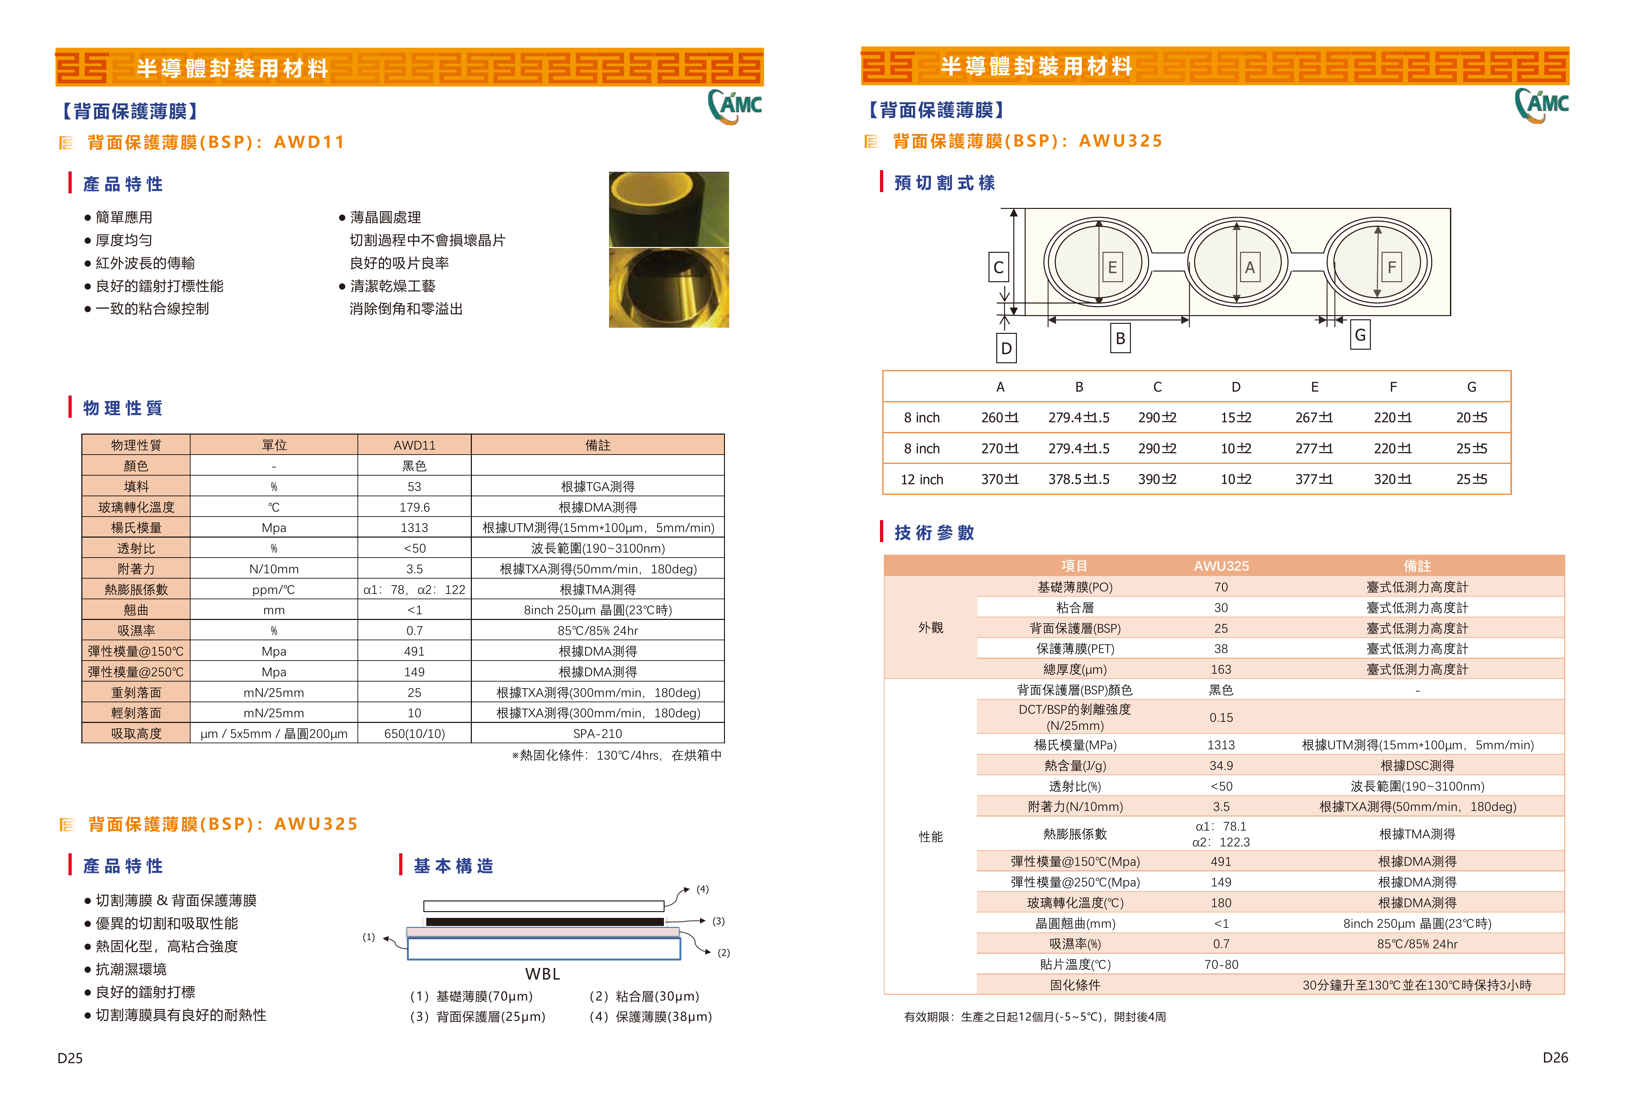

Slide 6
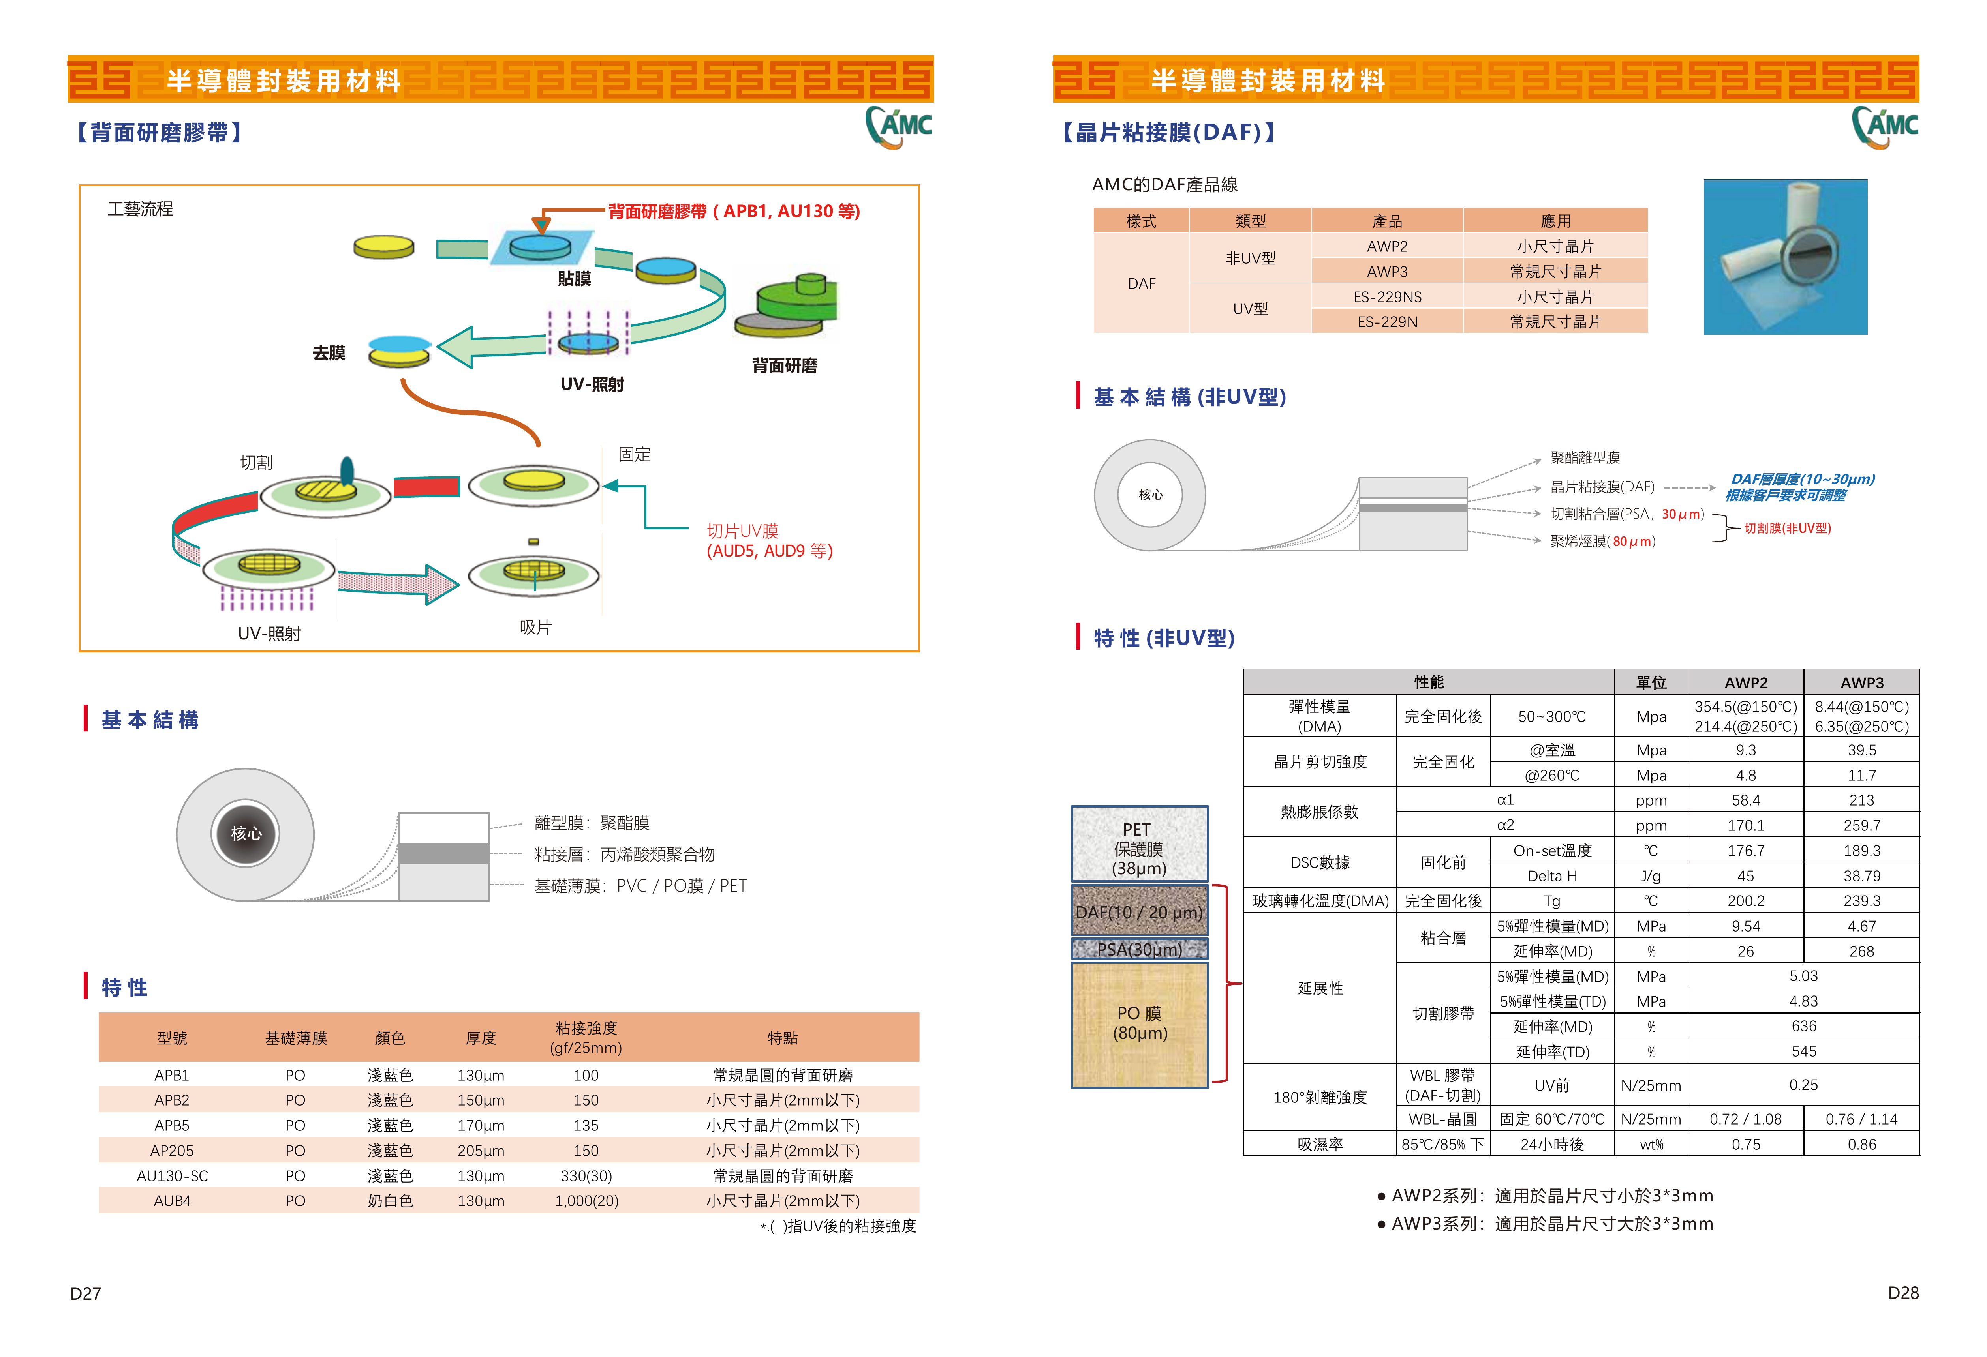

Slide 7
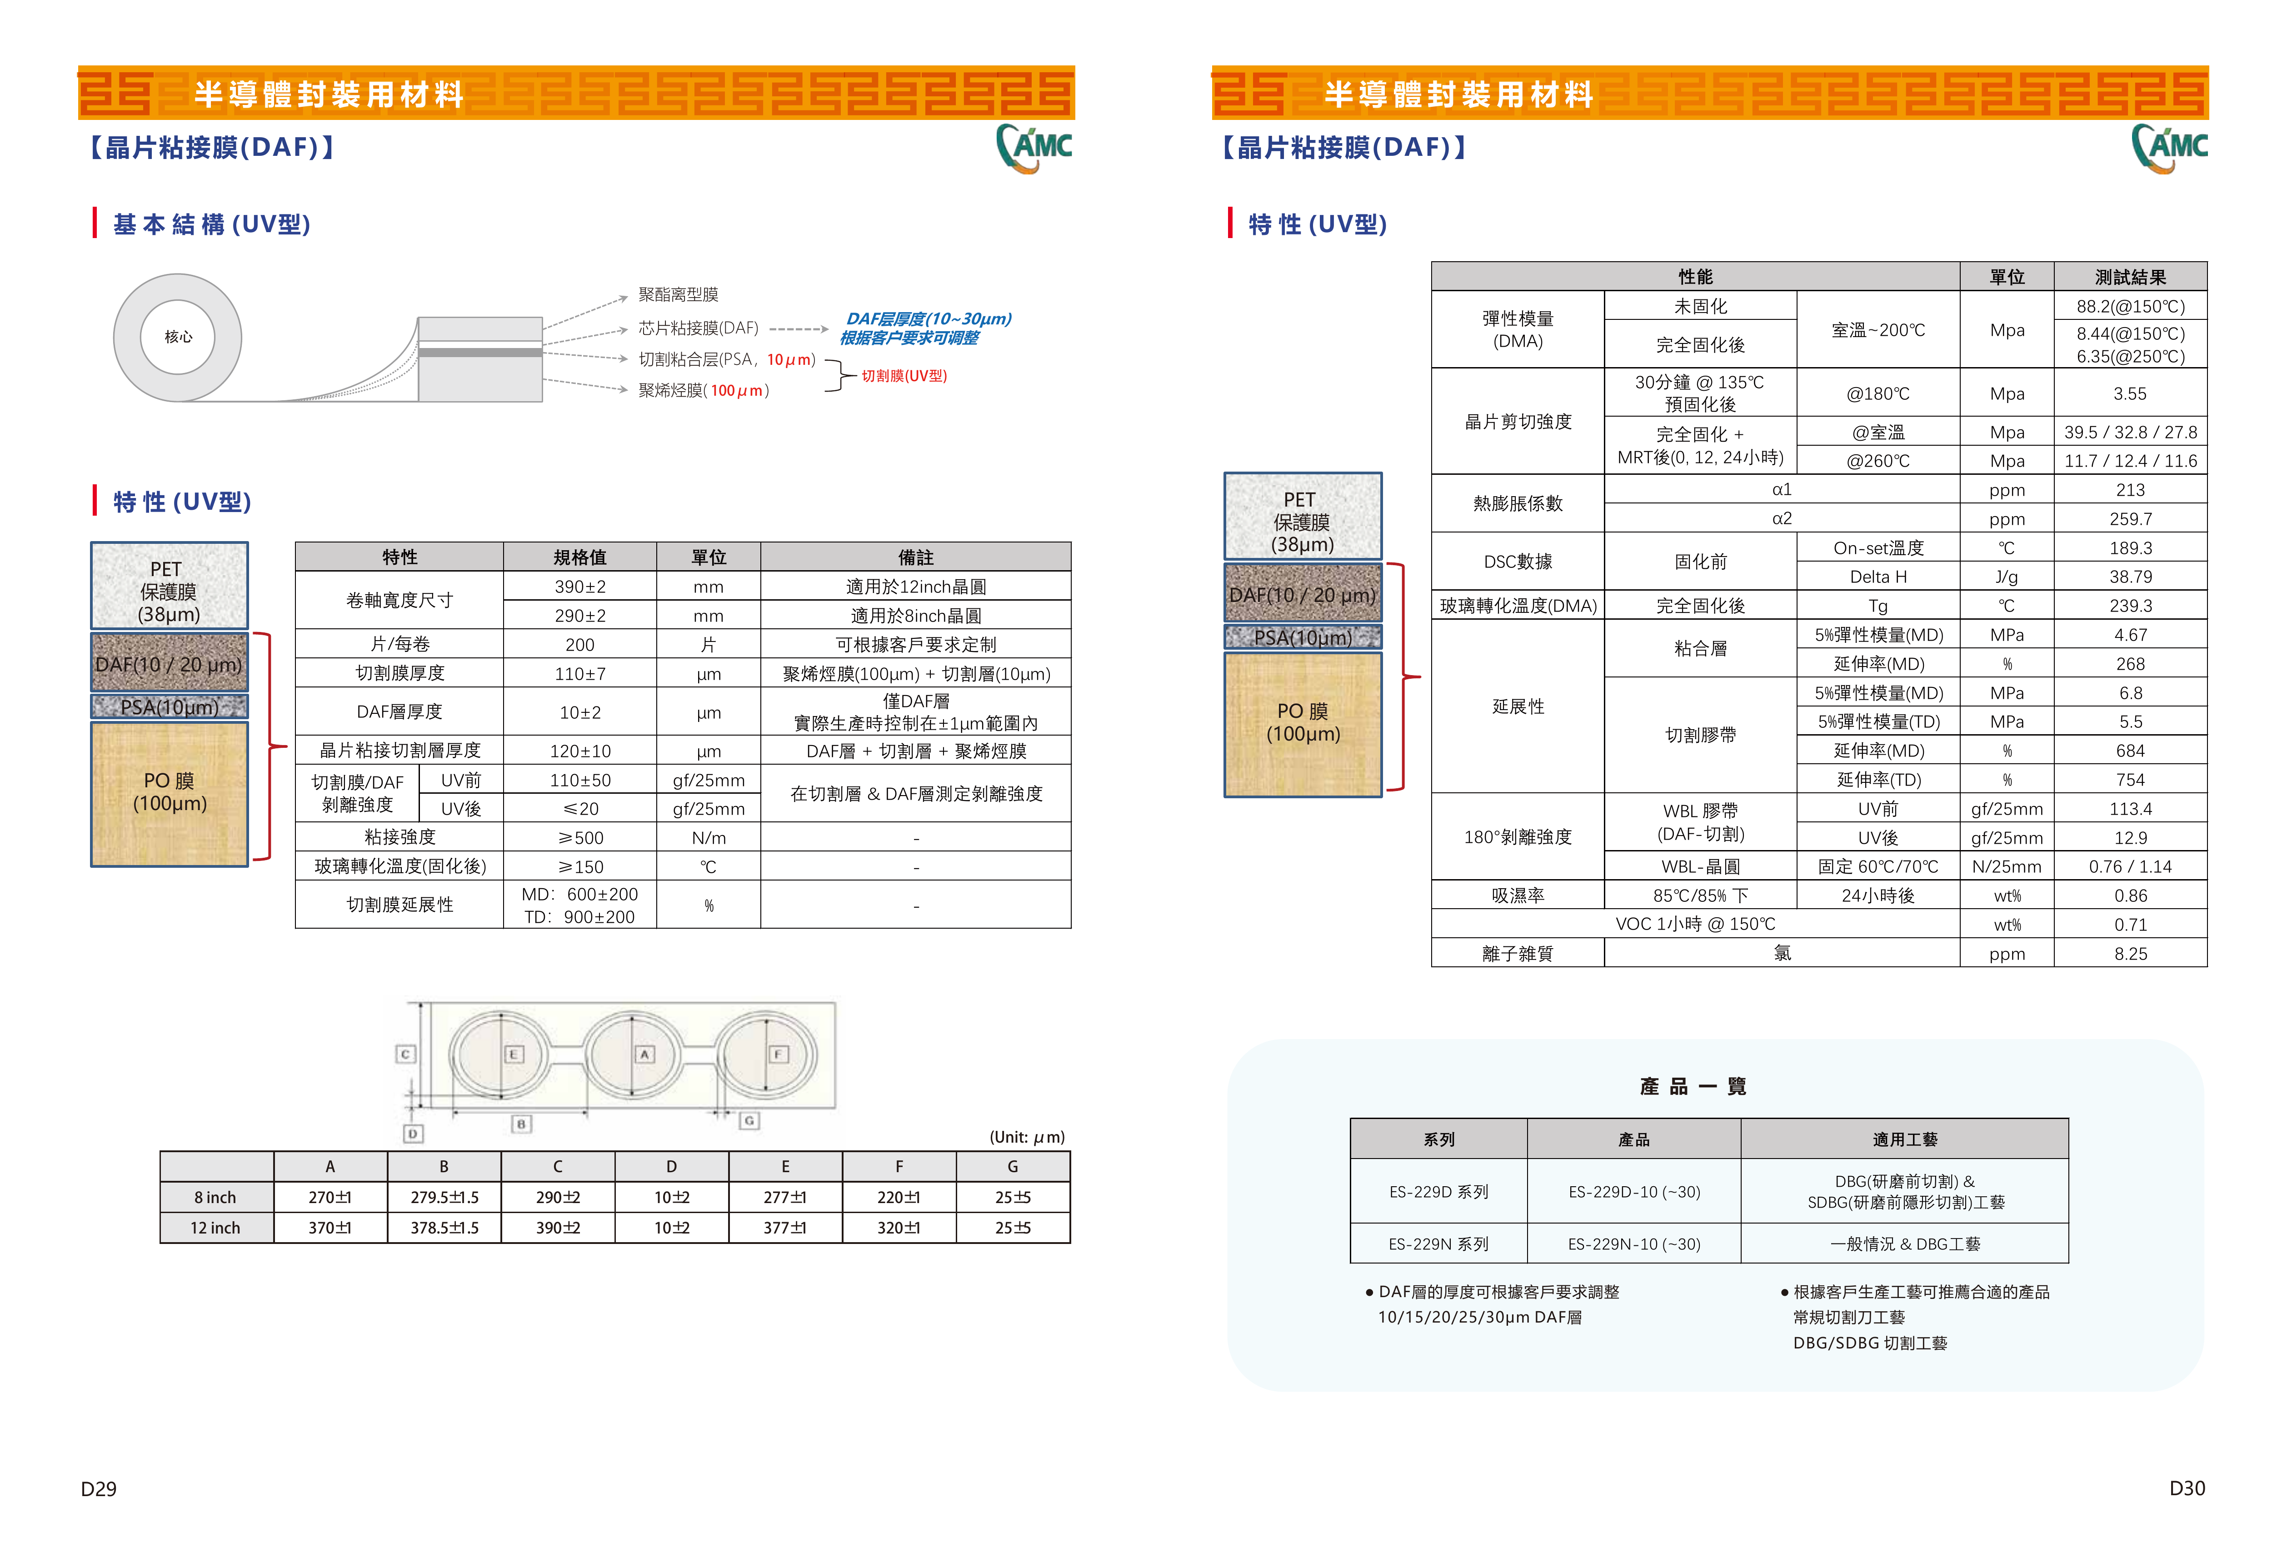

Slide 8
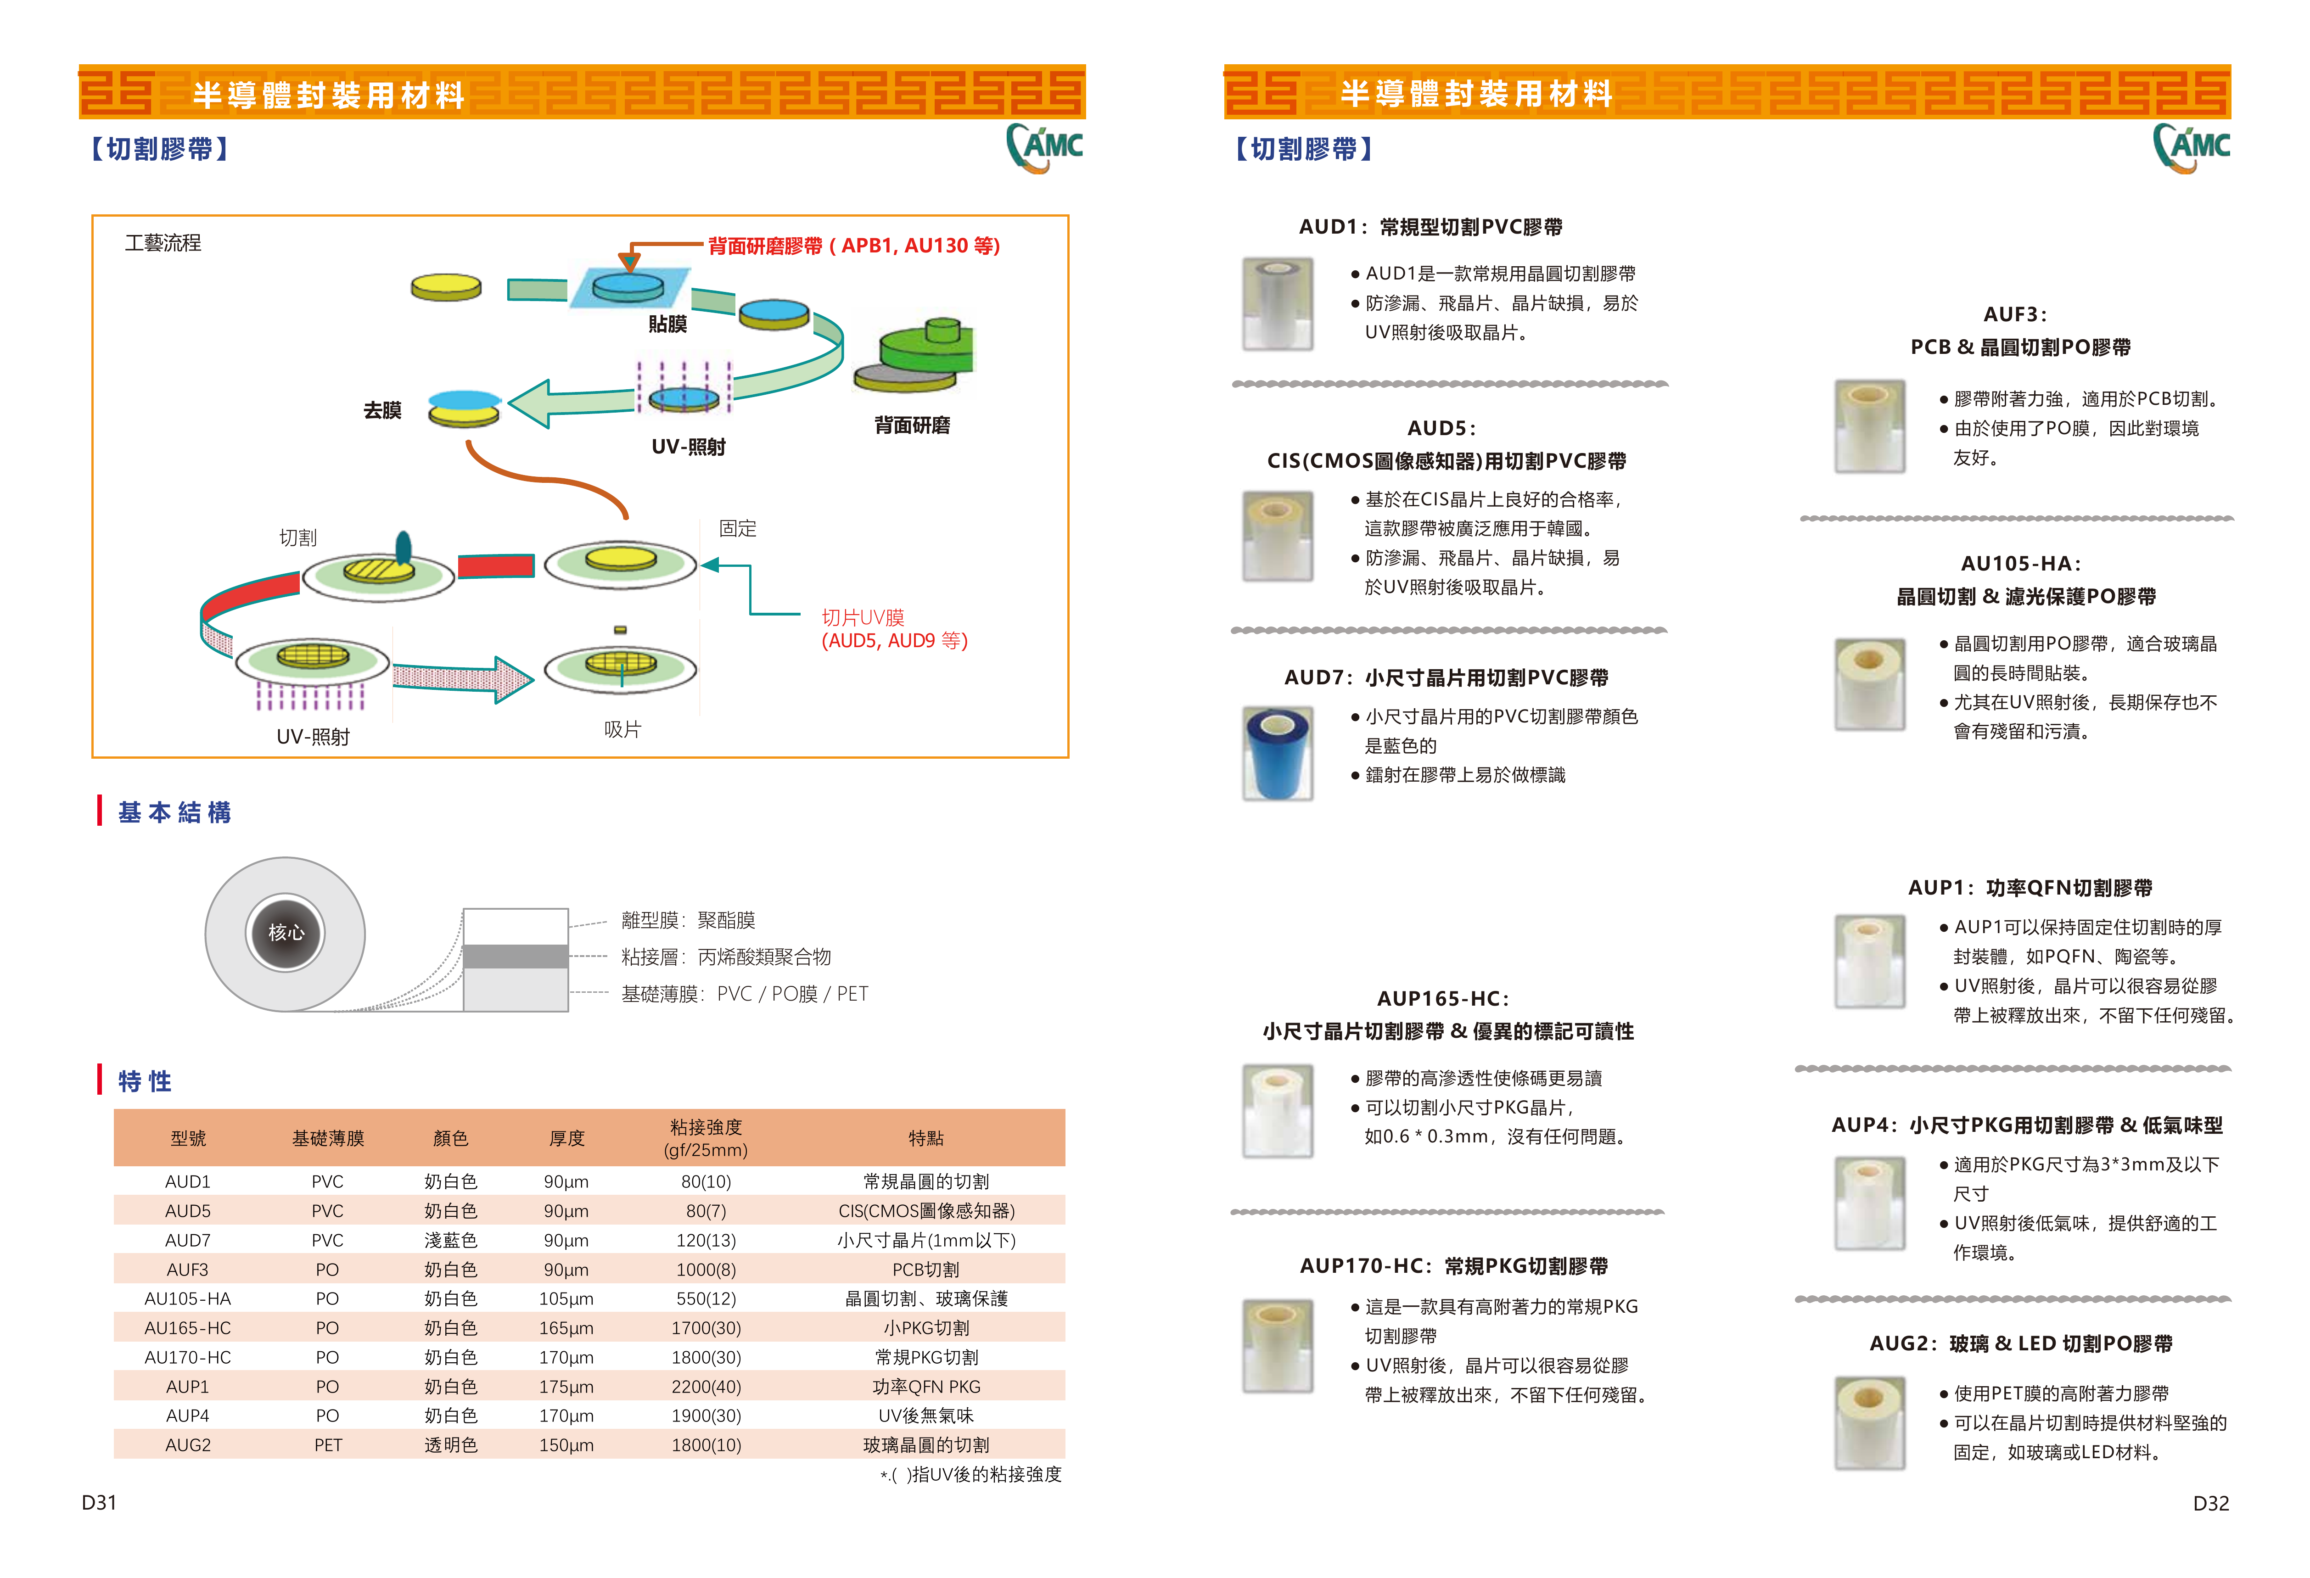

Slide 9
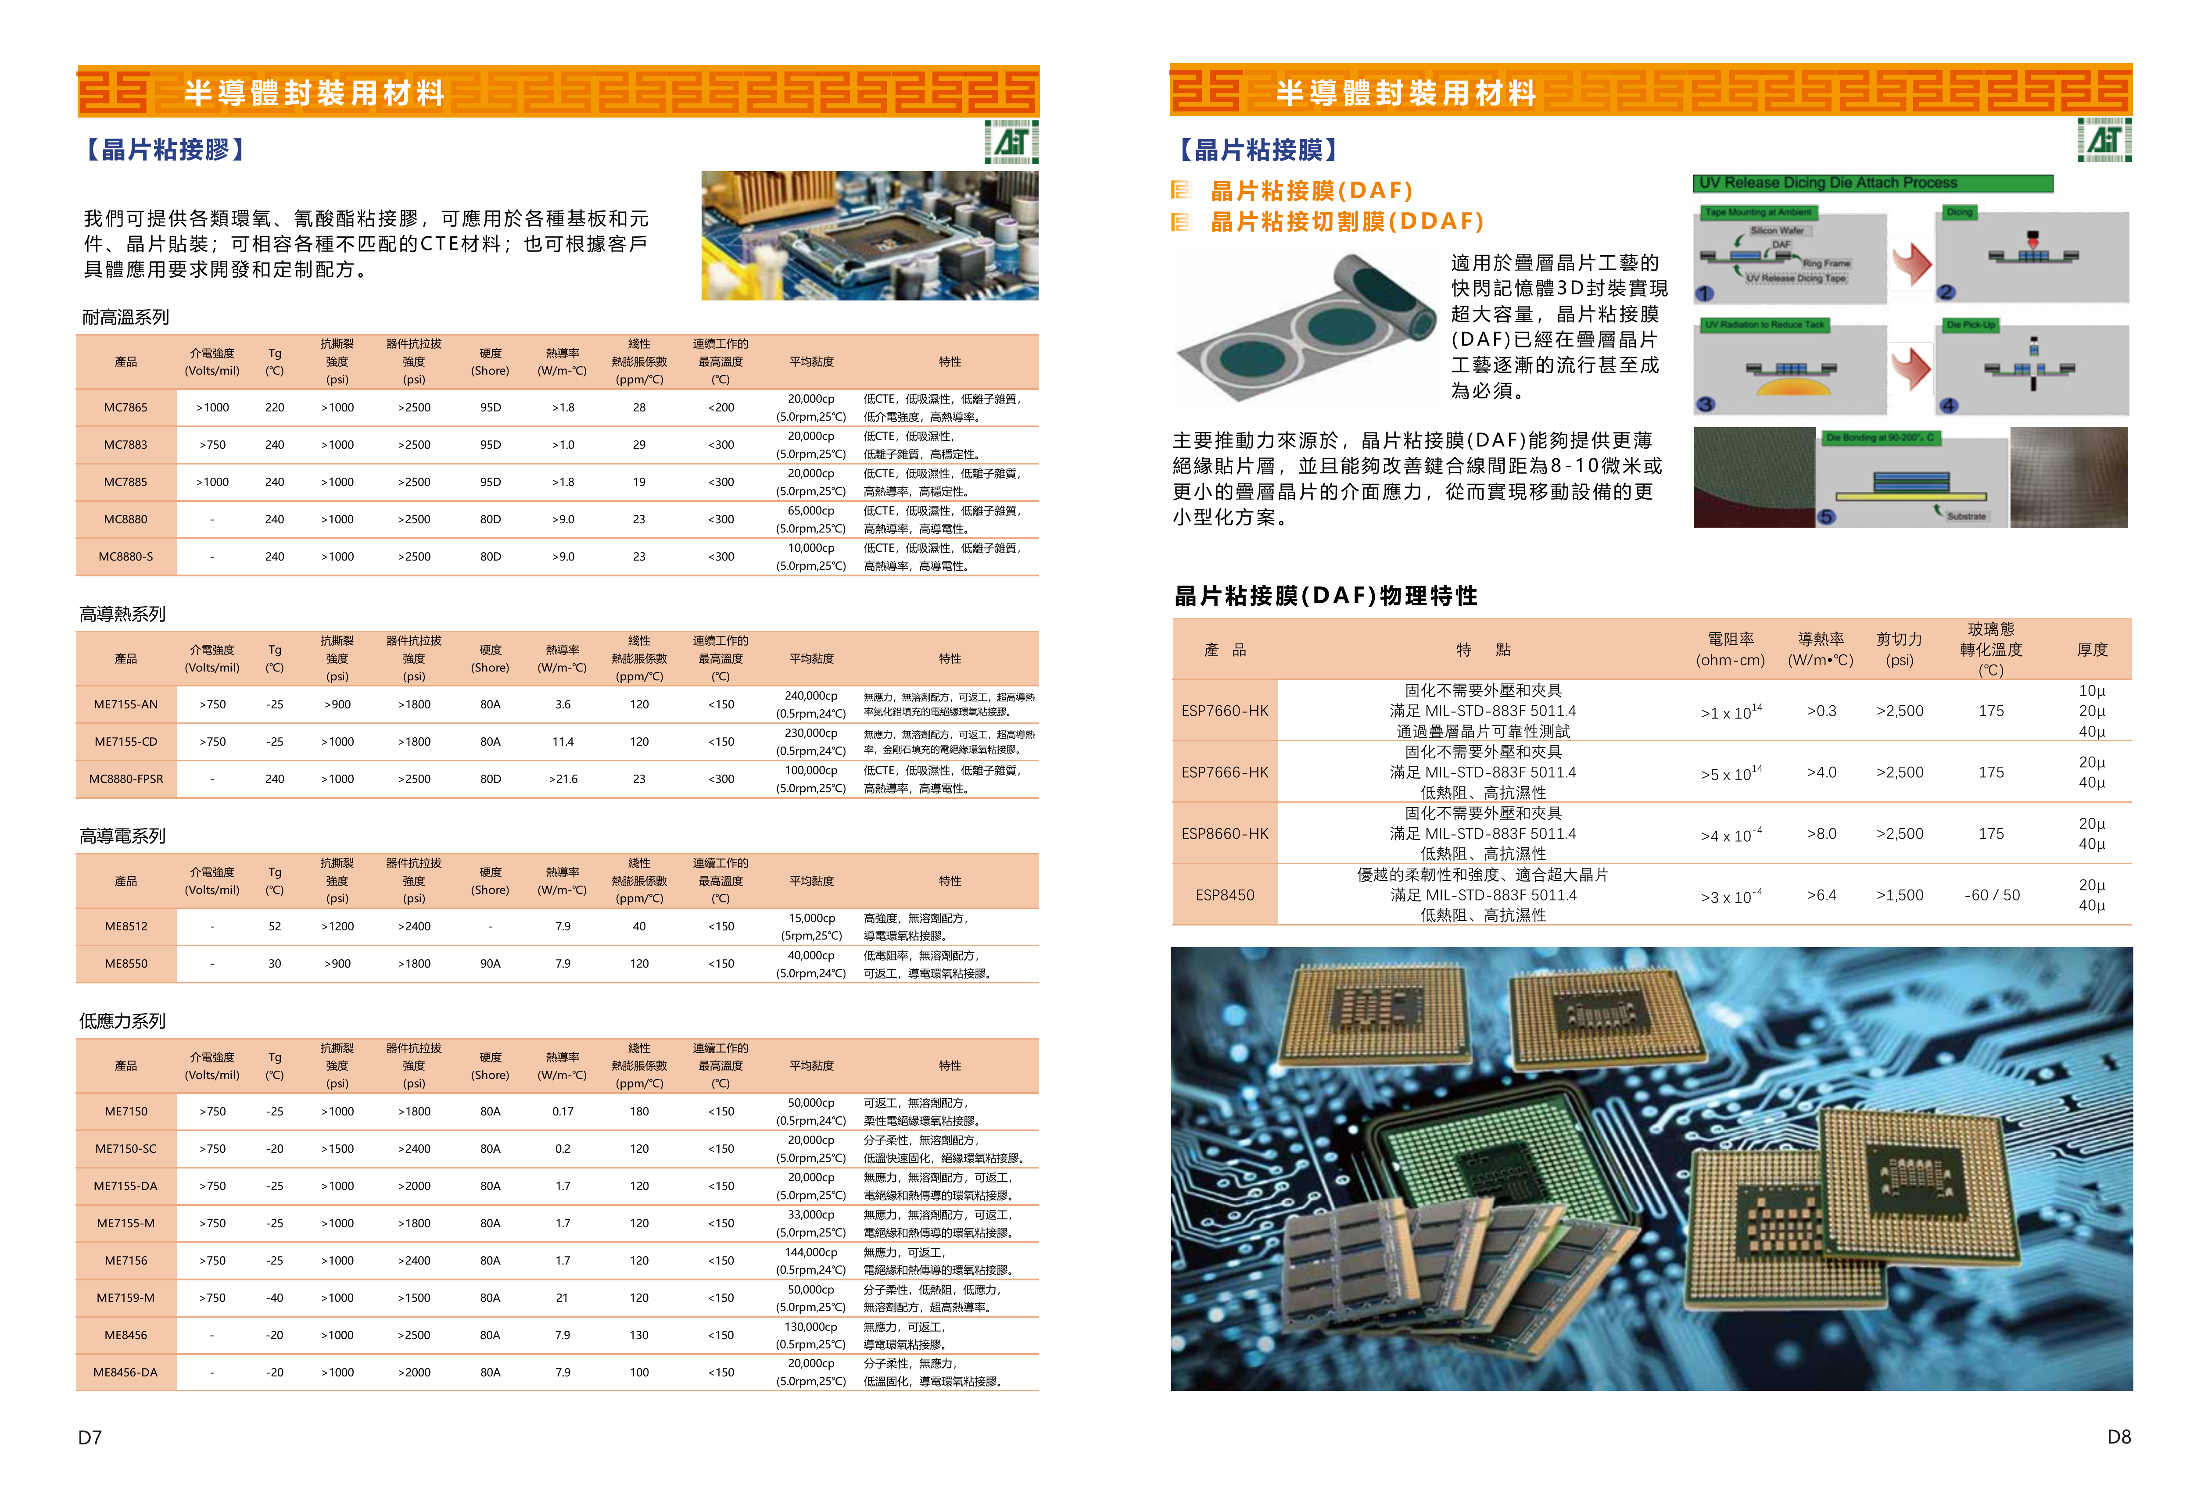

Slide 10
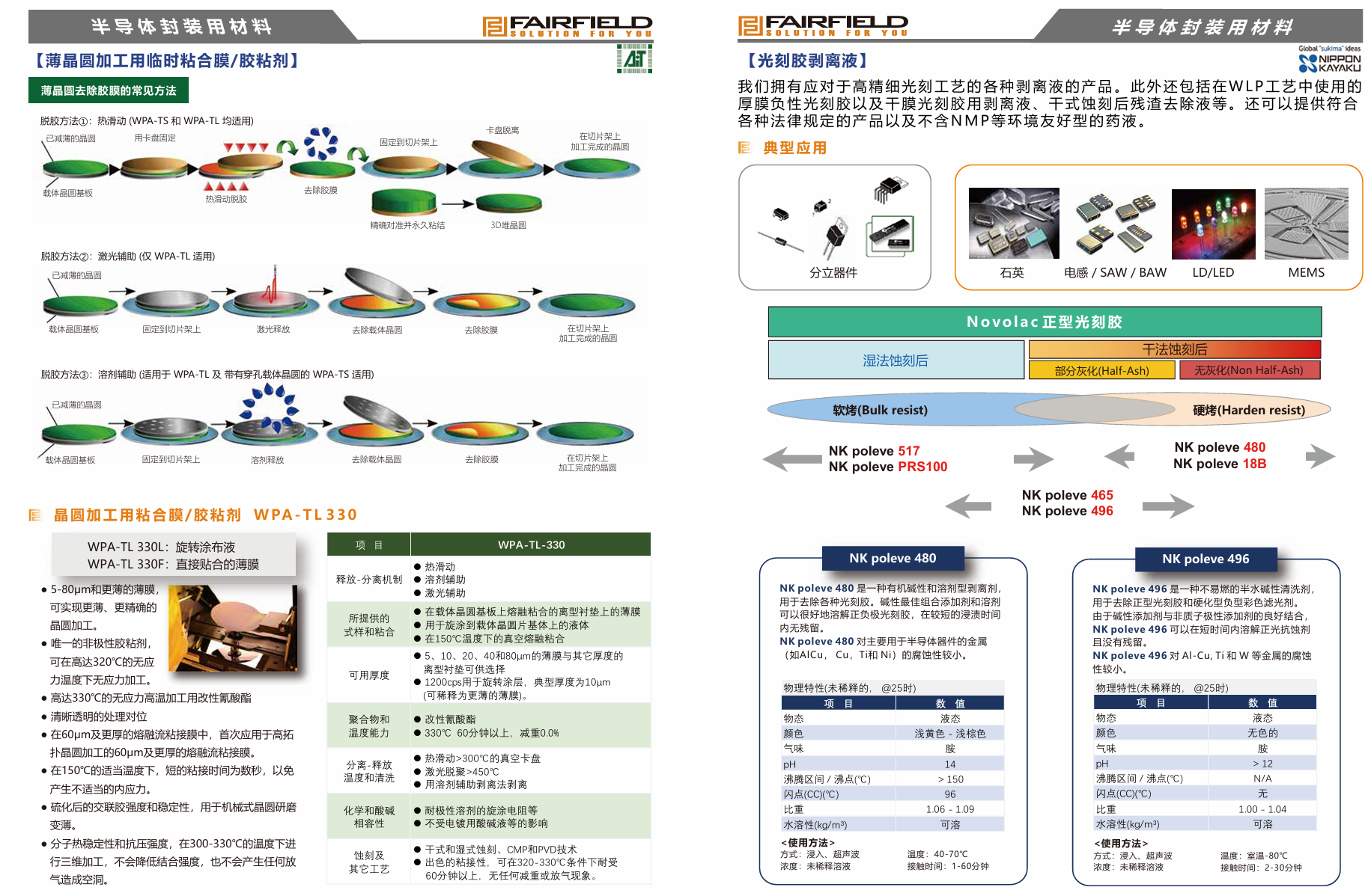

Slide 11
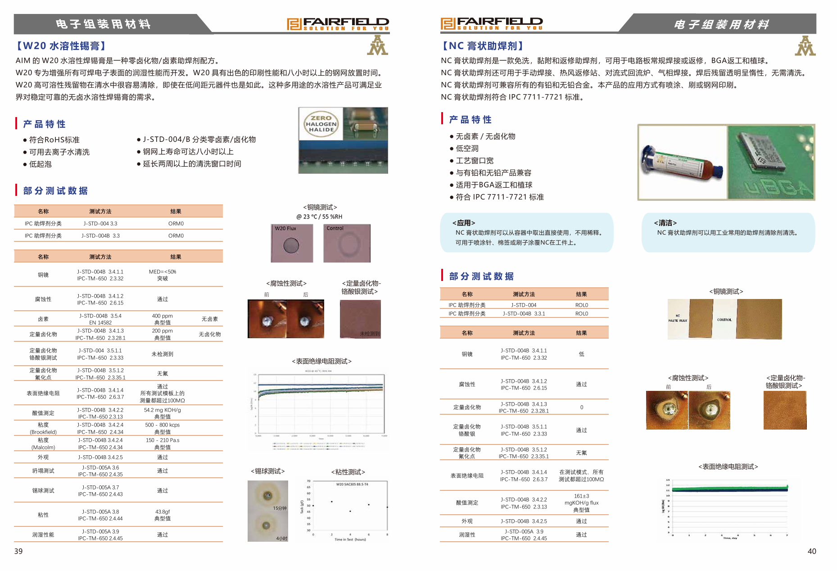

Slide 12
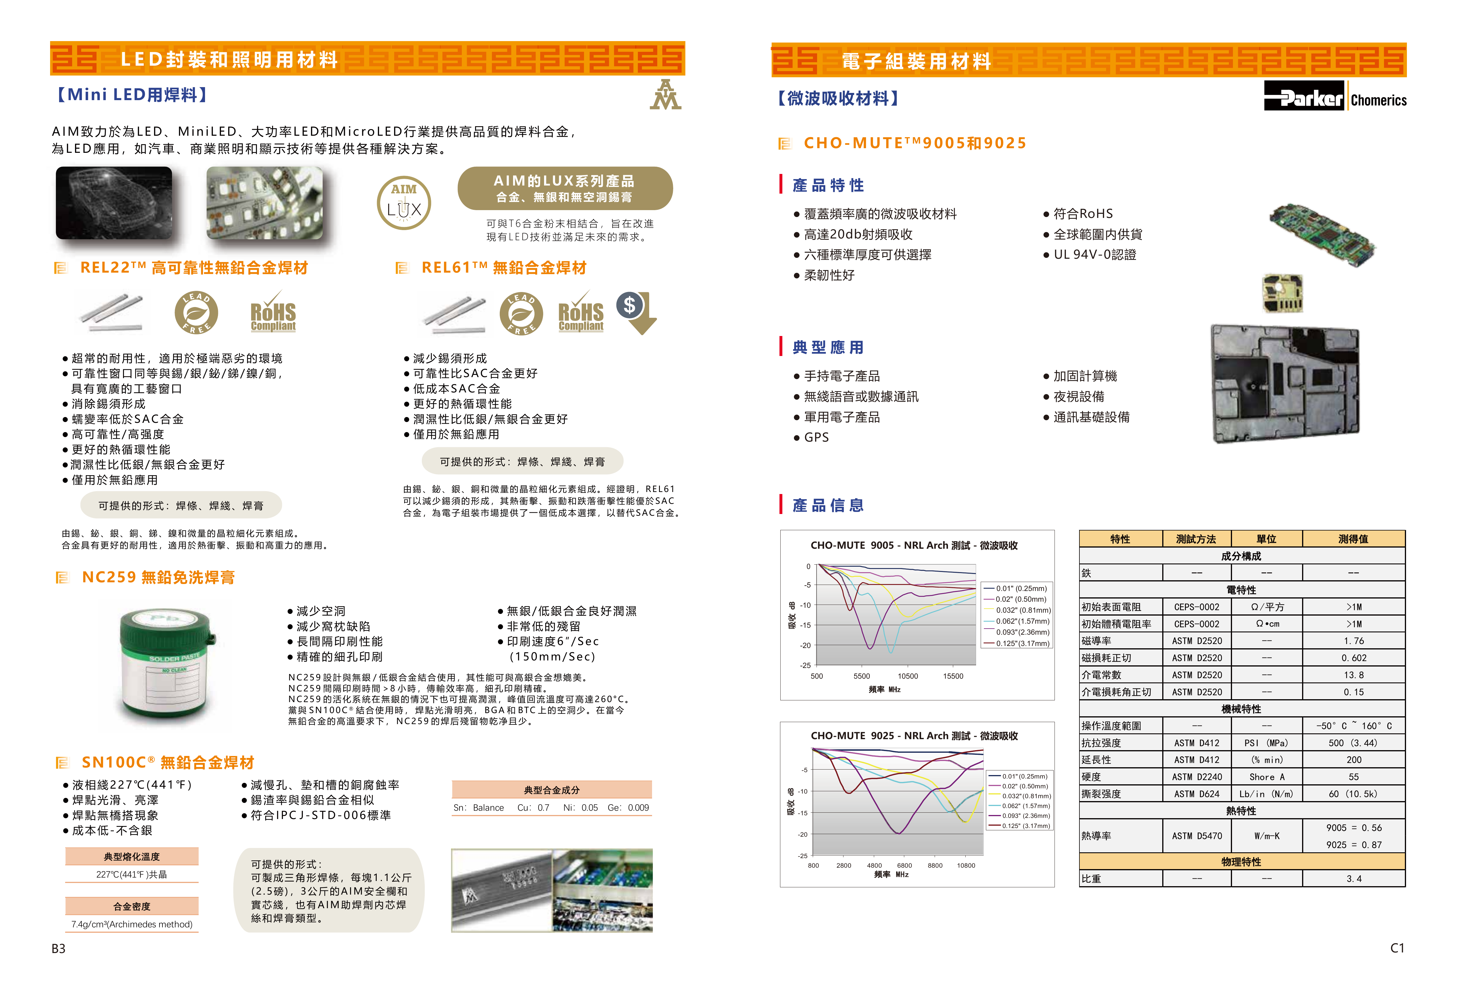

Slide 13
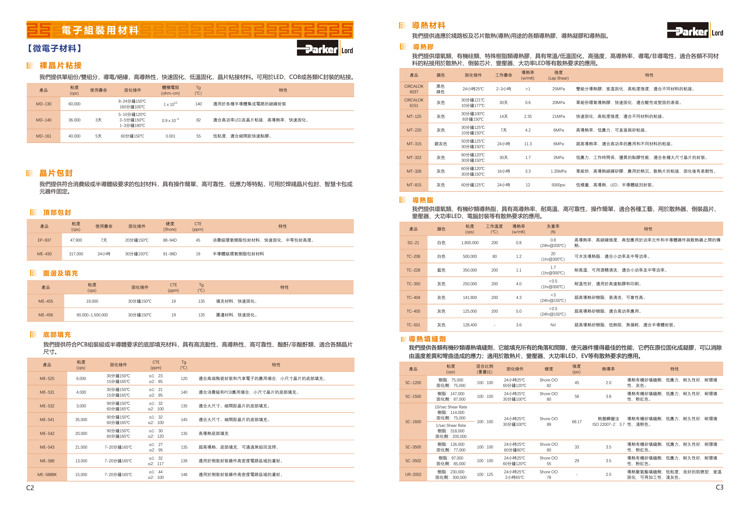

Slide 14
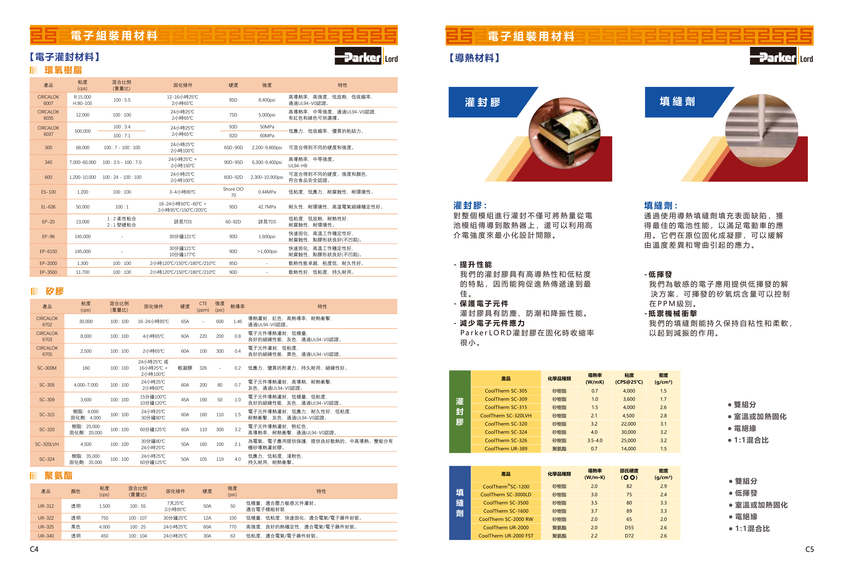

Slide 15
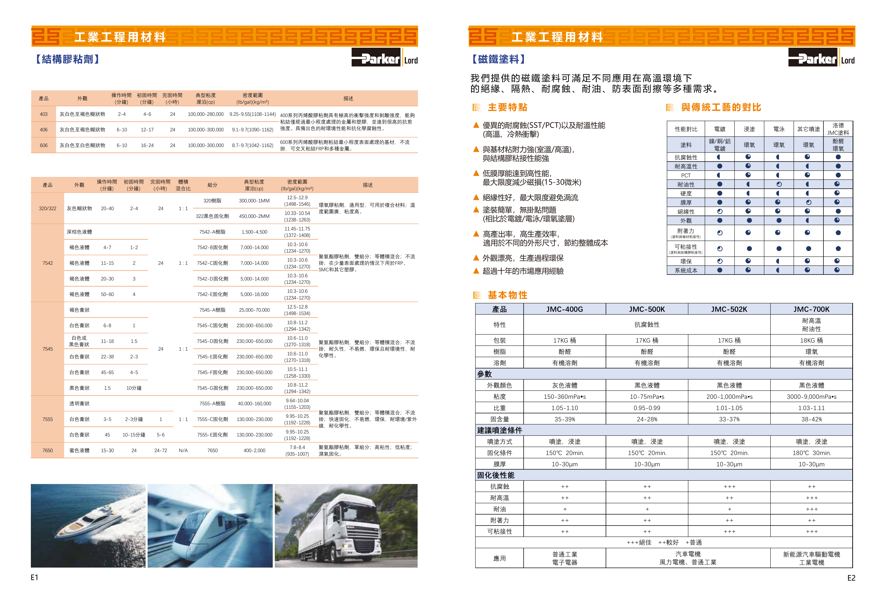

Slide 16
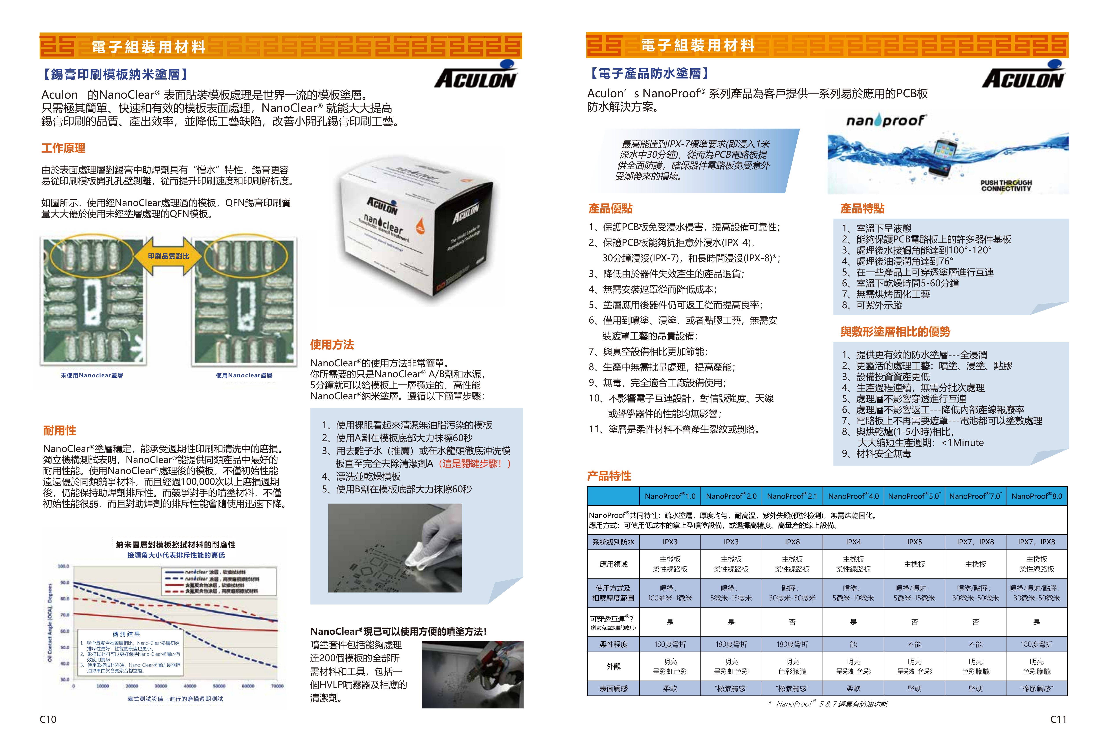

Slide 17
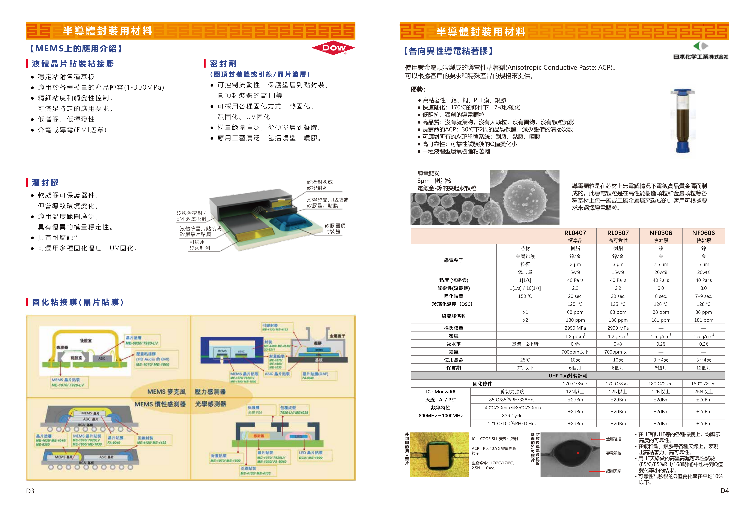

Slide 18

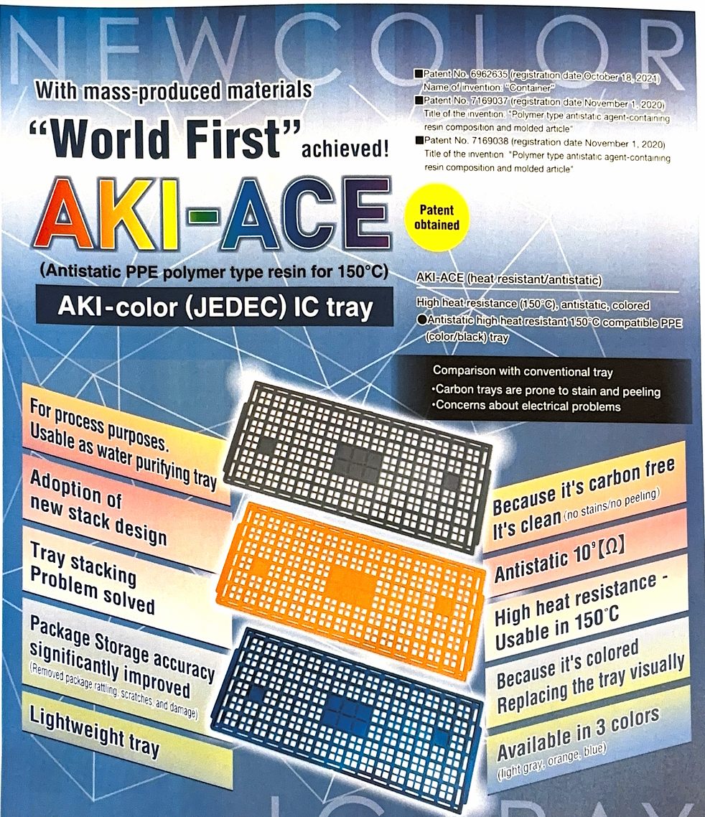
Introduction to AKI-ACE IC Tray
Advantage ( 優勢)
1.Carbon-free (零碳)
2.Carbon-dust-free (零碳塵)
3.Lighter than other tray, saving shipping cost (輕, 省運費)

Slide 19
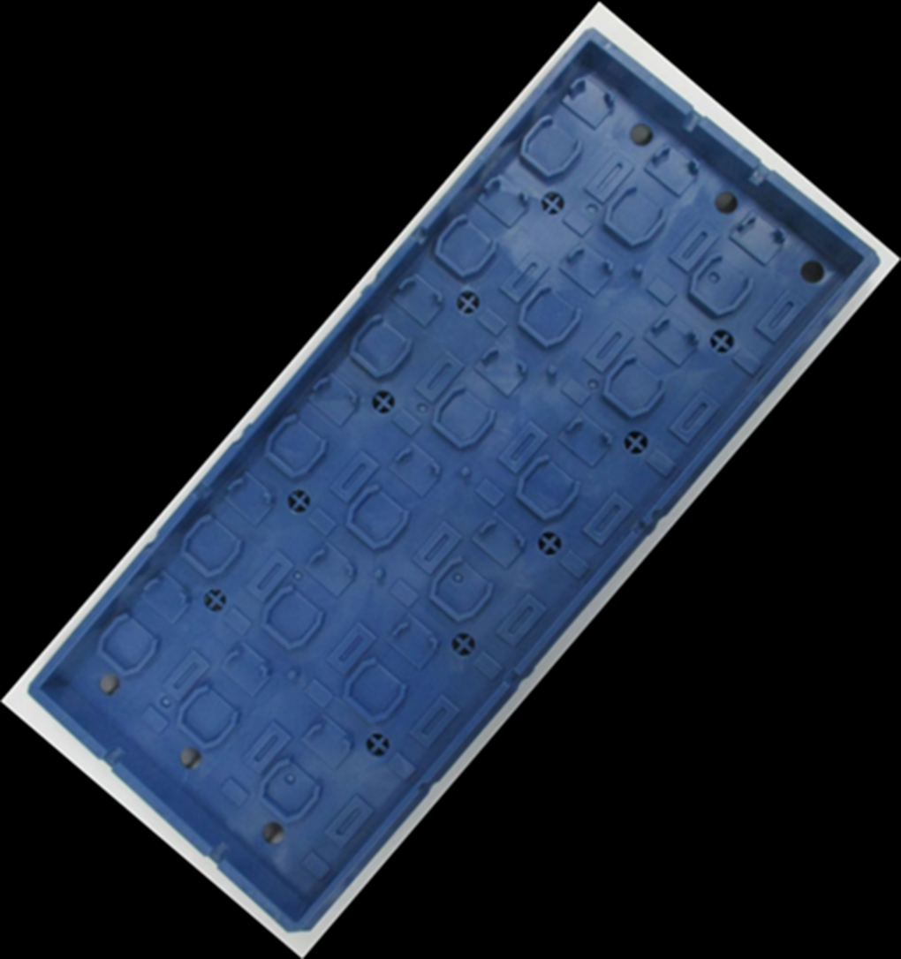
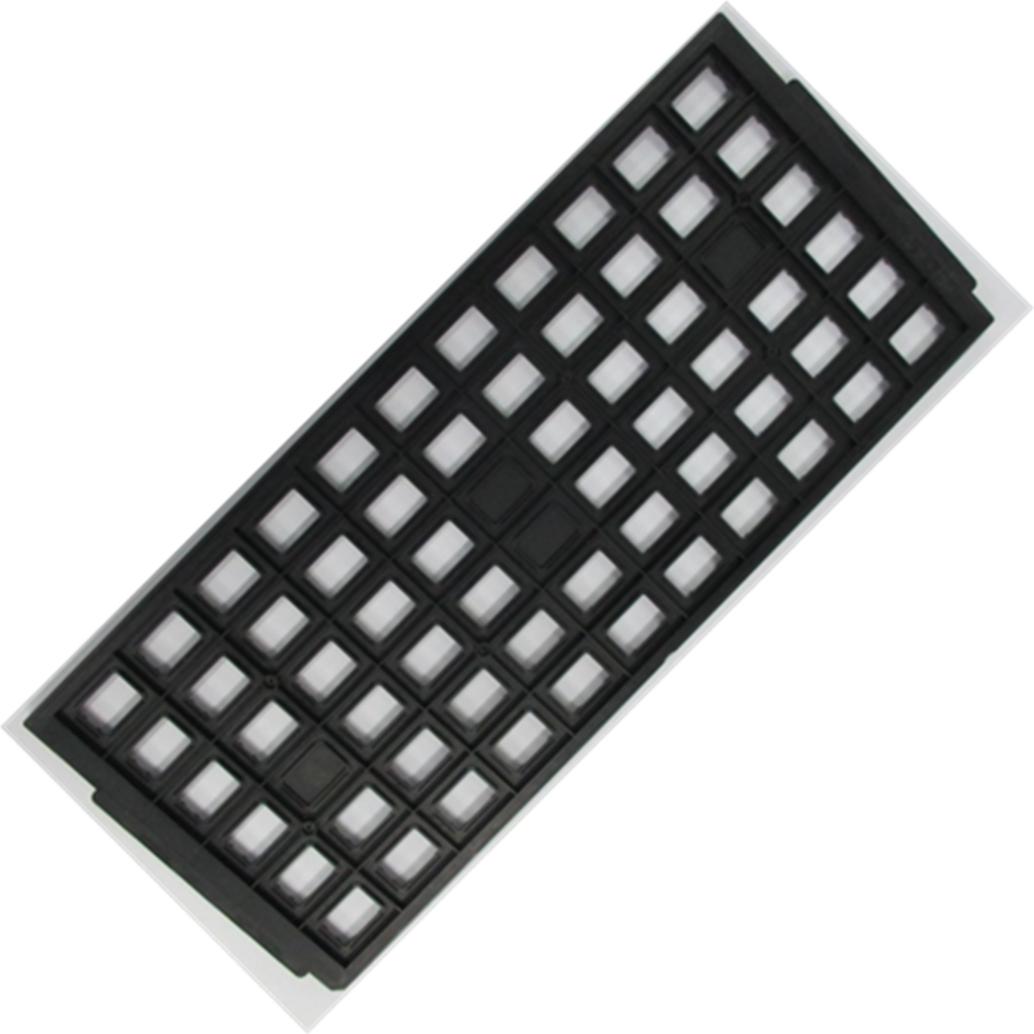
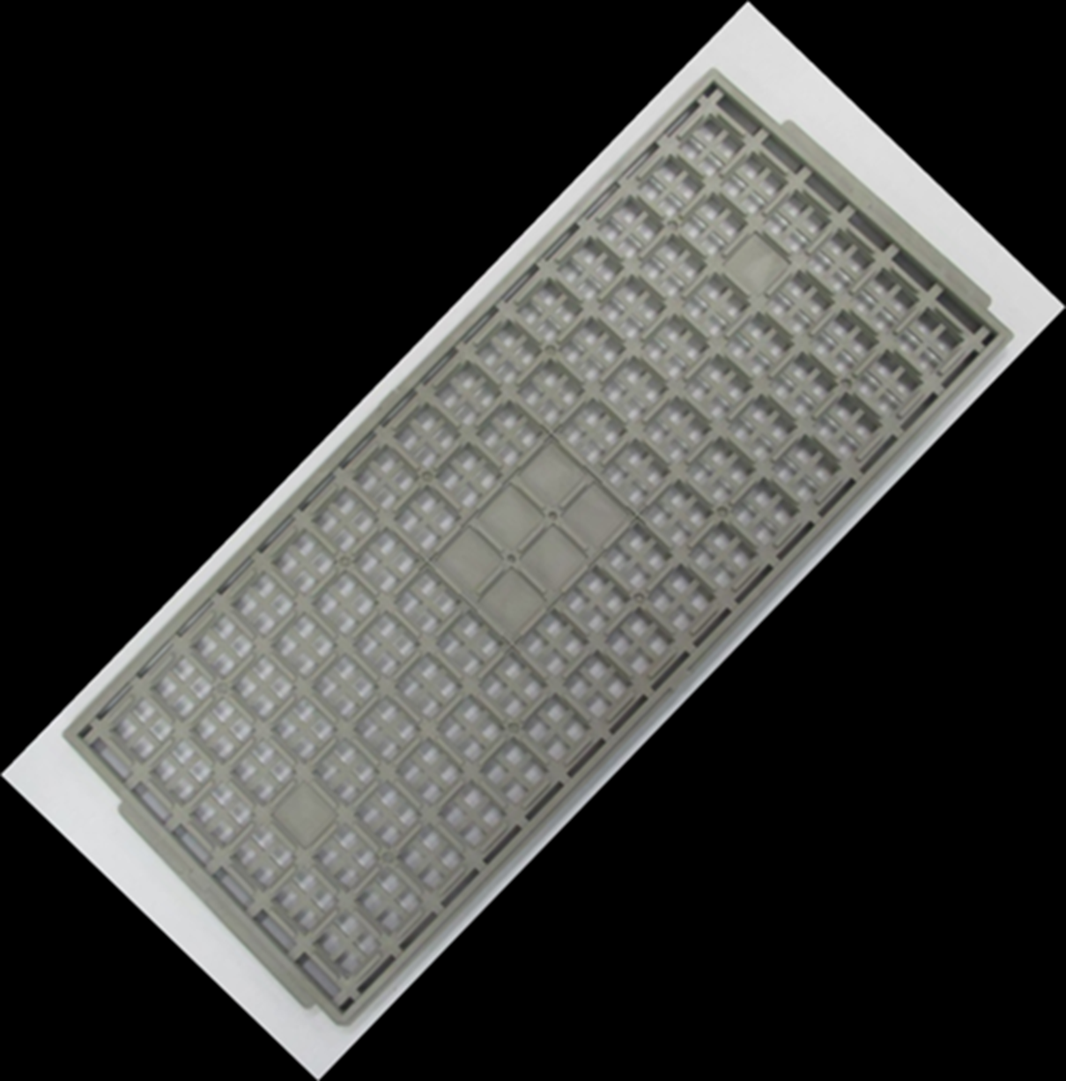
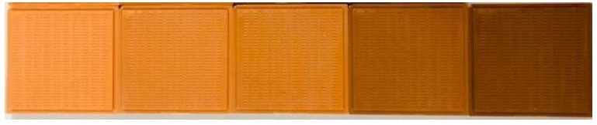
Features of AKI-ACE
Material characteristics
  Carbon-free IC Tray material
    polymer-based dissipative resin
    use at 150°C
    industry’s first mass produced material
  Cleanest and safest IC Tray material
    no staining, no peeling, and no risk of electrical failure
  Colorable material
    standard type: dark brown
    colored type: orange, blue and gray (customized colors are also possible upon request)
  Visually identifiable
    when it is time to replace the tray
  Dissipative property
    “low 10^9Ω range" is realized
  Applicable to pure water washing (for process tray)
    also durable against high temperature drying
Confidential

Slide 20
Features of AKI-ACE
Features of AKI-ACE JEDEC IC Tray
  Adoption of new stack design which;
    significantly improves package (PKG) storage accuracy
    reduces damage to the package (PKG)
    mitigates IC Tray and stack defects
  Lightweight
    AKI-ACE Tray： 10～30％ lighter (same Tray design)
Reference : weight comparison of different JEDEC trays
 | sample 1 | sample 2 | sample 3 | sample 4 | sample 5 | sample 6 | AKI-ACE
weight (g) (Pocket Quantity) | 204 ( 364 ) | 165 ( 112 ) | 185 ( 96 ) | 123 ( 12 ) | 149 ( 4 ) | 163 ( 4 ) | 115 ( 90 )
*sample 1-6 are all carbon fiber-based trays
**size and the number of pockets of the above trays are not identical
Confidential

Slide 21
Products :
1. Glass Carriers for Thin Wafer Handling / Temporary Bonding
2. Process Tools for Wafer Handling
3. Packaging Wafers Patterned Cap Wafers
4. Glass Interposer / TGV
confidential - no distribution without prior written consent

Slide 22
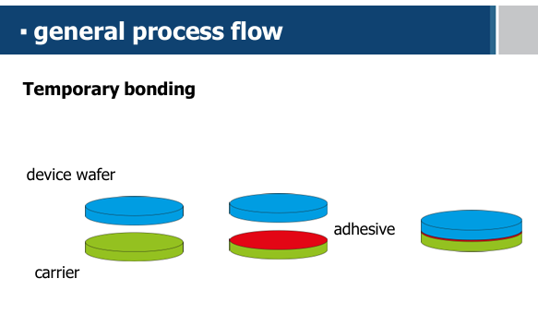
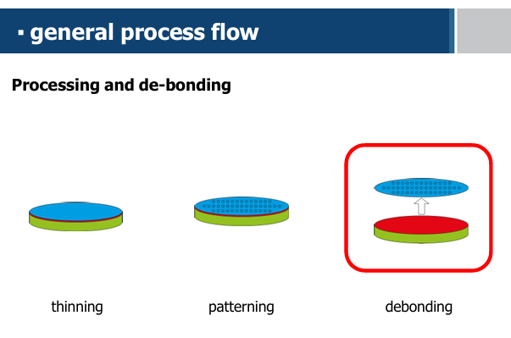
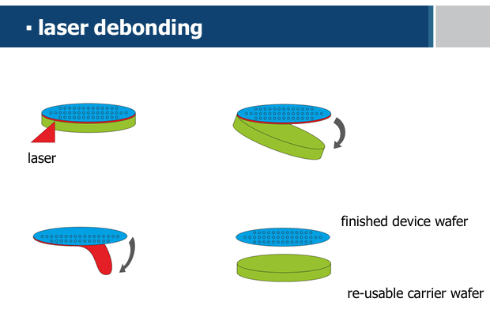
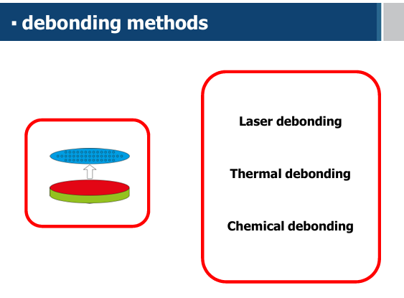

Slide 23
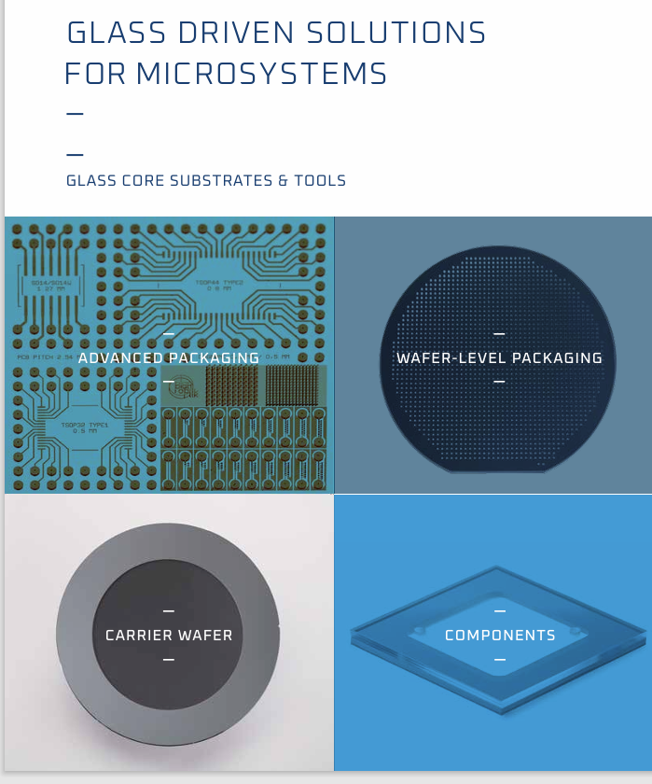
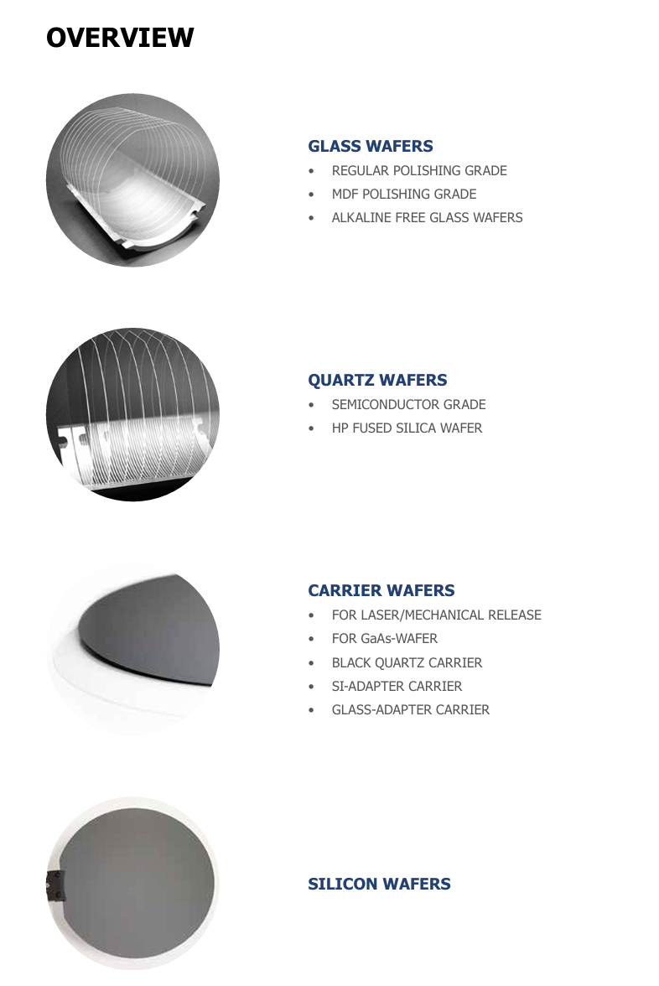


Slide 24

Taiwan Fairfield Electronic Technology Co.,Ltd.
台灣銘奮電子科技有限公司
+886 939603219
Tony_Wang@Fairfield.com.tw
Contacting Person : Tony Wang
Thank you！

